Slide 1
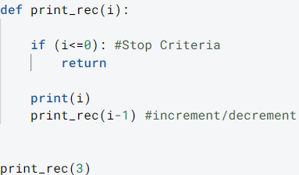


Slide 2
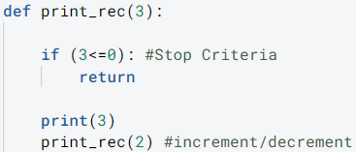
Call Stack
3
print_rec(3)

Slide 3
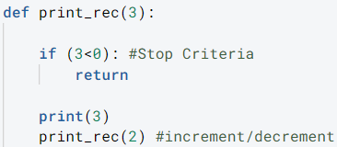
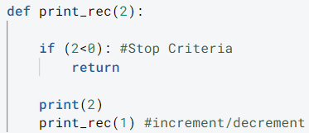
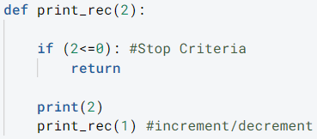
Call Stack
print_rec(2)
3
2
print_rec(3)

Slide 4
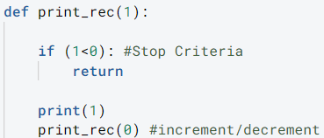
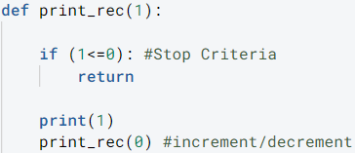
Call Stack
3
2
1
print_rec(1)
print_rec(2)
3
2
1
print_rec(3)

Slide 5

Call Stack
3
2
1
0
3
2
1
print_rec(0)
print_rec(1)
print_rec(2)
3
2
1
print_rec(3)

Slide 6
Call Stack
3
2
1
0
3
2
1
print_rec(1)
print_rec(2)
3
2
1
0
print_rec(3)

Slide 7
Call Stack
3
2
1
0
3
2
1
0
3
2
1
0
3
2
1
print_rec(2)
3
2
1
0
print_rec(3)

Slide 8
Call Stack
3
2
1
0
3
2
1
0
3
2
1
0
3
2
1
3
2
1
0
print_rec(3)

